Slide 1




Hack on Real-Life Challenges
Digitizing a Paper Records form with Optical Character Recognition
Vishal Kumar Saw

Slide 2

Problem Statement
Develop a Document Processing Platform for Insurance Providers and Bankers that will help to digitizing a Paper Records form with Optical Character Recognition

Slide 3
THE SOLUTION

Slide 4
Brief Synopsis of the Challenge
Insurance Provider Agent or Bank Agent should have ability to upload sample paper form and map it with variety of fields like square, signature, checkbox, text field along with multiple pages
Extracted data should be stored in database and shown to operator for correctness
Multiple Versions of the same form should be available on mobile devices for Agents to have touchless uploads
Machine Learning for OCR algorithm to achieve more and more accuracy

Slide 5
Problem Being Addressed and Solved
Paper based Baking forms are critical to Insurance Provider and banks for managing their customer enrollment & maintenance processes.
Amazon Textract is a fully managed machine learning service that automatically extracts text and data from scanned documents.
Amazon Textract process the response with the Amazon Textract parser library.

Slide 6
Technology/Tool/stack
List of technology stack being used
Spring Boot – Integrator, data correction GUI, DB Storage & API provider
AWS S3 bucket – Image and PDF upload and storage
AWS Lambda – Lambda function for Textract API
AWS Textract – Extracts text and data from scanned documents
AWS Dynamo DB – Store form data
AWS SNS – Job completion notification
React – Responsive UI

Slide 7
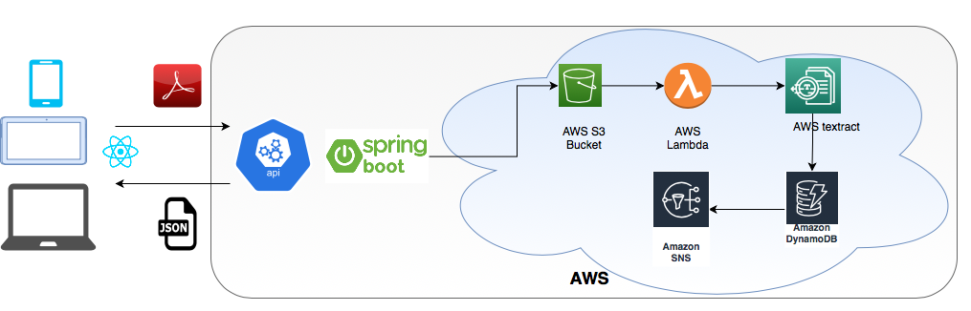
Solution Architecture

Slide 8
Prototype/MVP Demo Video/Screenshots
Sample form

Slide 9
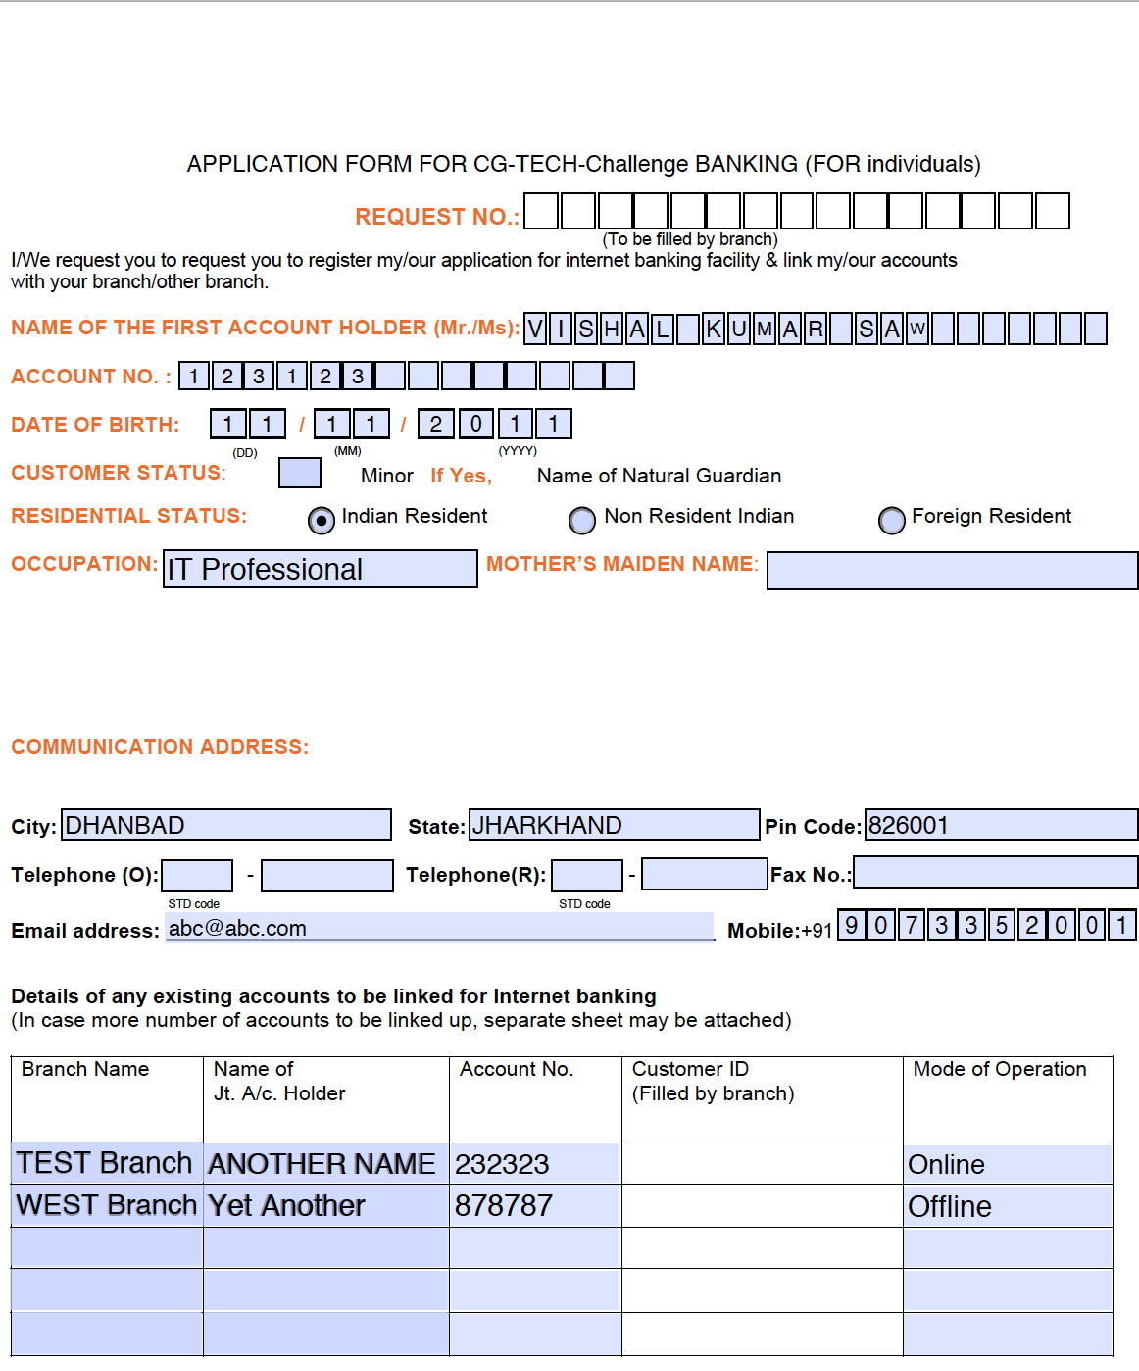
Prototype/MVP Demo Video/Screenshots
Sample Filled
form

Slide 10
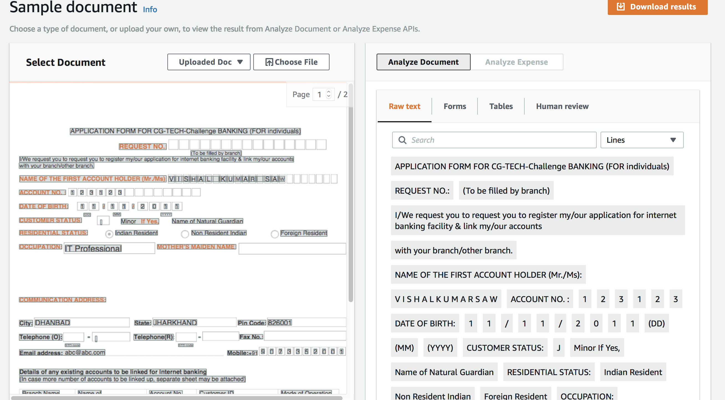
Prototype/MVP Demo Video/Screenshots
Sample Filled
Form
extraction

Slide 11
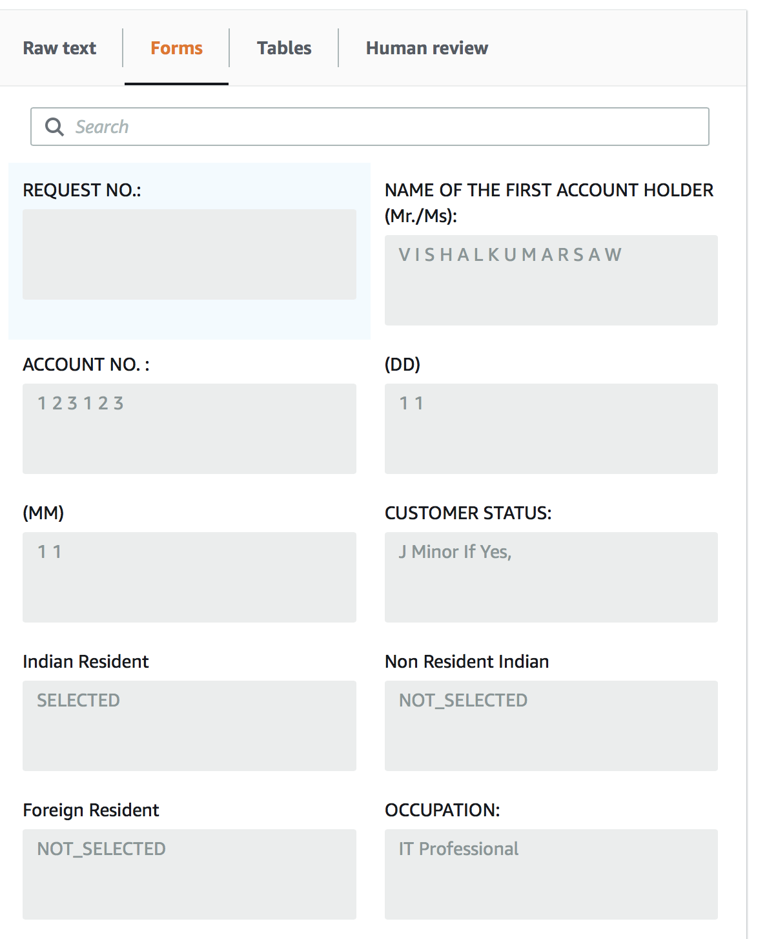
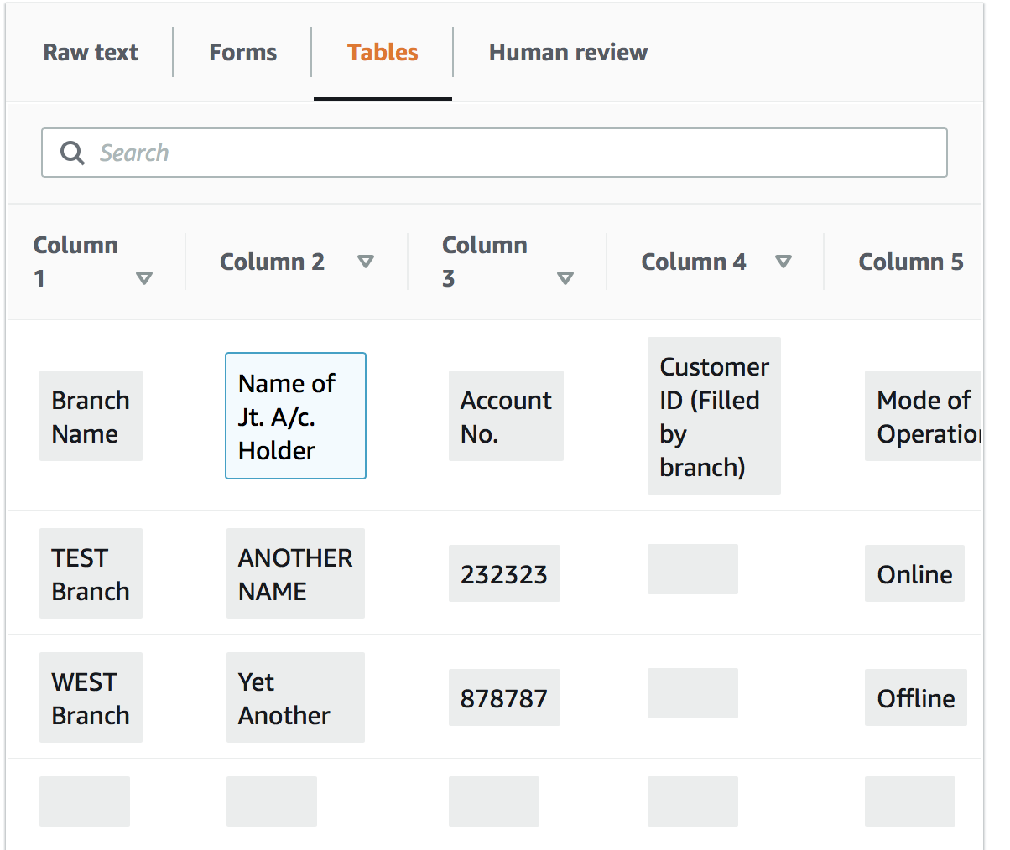
Prototype/MVP Demo Video/Screenshots
Sample Filled
Form
extraction

Slide 12
Challenges Faced
Data scanning accuracy
Skew correction
Data mapping of the scanned form with Database tables

Slide 13
Way Forward with the solution

Slide 14
Future Enhancements
1
3
Batch Processing
For Bulk Upload
Searchable PDF Creation
2
Read & process dynamic form using NoSQL
4
Realtime scanning with mobile device camera

Slide 15
THANK YOU

